Slide 1
Appendix D
CDE User Customization

Slide 2
Unit Objectives
After completing this unit, you should be able to:
Use the Style Manager to interactively customize the desktop environment
Customize the Front Panel

Slide 3
Customizing CDE
Most features of CDE are customizable
Interactive Tools
Command Line Options
Configuration Files
Front panel layout
Fonts, Colors, Backdrop
Workspace Switch

Slide 4
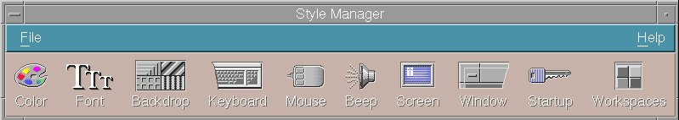
Style Manager Overview

Slide 5
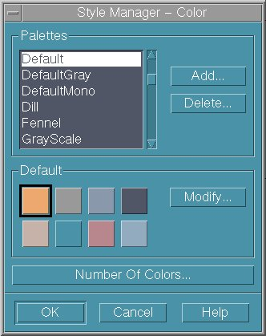
Style Manager - Colors

Slide 6
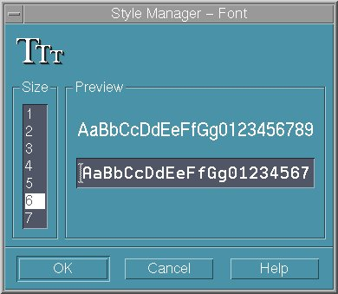
Style Manager - Fonts

Slide 7
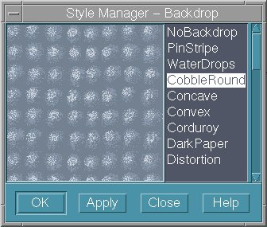
Style Manager - Backdrops

Slide 8
Style Manager - Keyboard, Mouse, and Beep
Mouse button click settings
Double click speed
Pointer acceleration
Pointer movement threshold
Key click volume
Character repeat capability
Volume
Tone
Duration

Slide 9
Style Manager - Window, Screen, and Startup
Window focus policy
Window raises policy
Window icons placement
Current Session or Home Session
Whether to prompt at logout time for subsequent session
Screen saver
Lock timeout

Slide 10
Activity: Review Style Manager

Slide 11
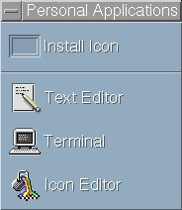
General Structure of a Front Panel
Subpanel
Control
Panel
Box
Control
Control
Switch

Slide 12

Creating a New Workspace
Click the right mouse button

Slide 13
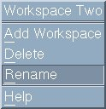
Changing a Workspace Name
Click the right mouse button
Joes

Slide 14
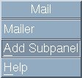
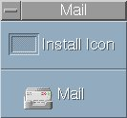
Dynamic Creation or Deletion of a Subpanel
Click the right mouse button

Slide 15
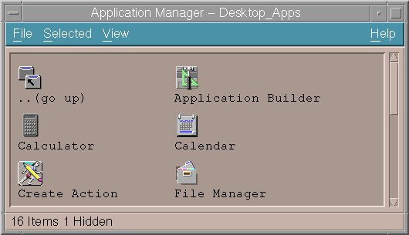
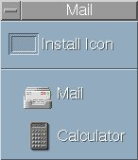
Adding a Control to a Subpanel
Drag the Action Icon onto the Install Icon

Slide 16
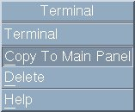
Copy a Subpanel Control to the Main Panel
Click the right mouse button

Slide 17
Adding Controls to the Front Panel (1 of 2)
1. Add the Control to a Subpanel:
2. Find out the name of the definition file for this control:
$ ls $HOME/.dt/types/fp_dynamic
Dtcalc1.fp

Slide 18
Adding Controls to the Front Panel (2 of 2)
3. Copy the definition file to directory $HOME/.dt/types
$ cp $HOME/.dt/types/fp_dynamic/Dtcalc1.fp $HOME/.dt/types/joe.fp
4. Anchor the Control in the Front Panel:
$ vi $HOME/.dt/types/joe.fp
CONTROL Dtcalc
{
...
CONTAINER_TYPE BOX
CONTAINER_NAME Top
POSITION_HINTS last
...
}
5. Restart the CDE
6. If you can not log in to the CDE, use Failsafe Session login

Slide 19
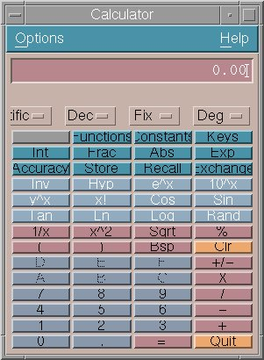
Extended Front Panel

Slide 20
Checkpoint
How do you customize the screen saver in your desktop environment ?
True of false: You can have more than four workspaces on the CDE front panel.
Describe how controls can be added to the CDE front panel.

Slide 21
Checkpoint Solutions
How do you customize the screen saver in your desktop environment ?
    By using the Style Manager
True of false: You can have more than four workspaces on the CDE front panel.
    True
Describe how controls can be added to the CDE front panel.
    First add the control to a subpanel. Copy the definition file and anchor the control in the front panel.

Slide 22

Exercise: Customizing CDE

Slide 23
Unit Summary
Use the Style Manager to interactively customize CDE for color, fonts, backdrop, mouse, keyboard, beep and window behavior, the screen saver and startup options.
Interactively customize the Front Panel to add and rename workspace switches, add or delete a subpanel, add or delete a control in a subpanel, and copy a subpanel control to the Main Panel.
To add controls to the front panel, add them first to a subpanel. Copy the definition file and anchor the control in the front panel.

